Slide 1
DSE JDBC Driver Installation and Use
© 2018 DataStax, All Rights Reserved. DataStax is a registered trademark of DataStax, Inc. and its subsidiaries in the United States and/or other countries. Apache Cassandra, Apache, Spark, and Cassandra are trademarks of the Apache Software Foundation or its subsidiaries in Canada, the United States and/or other countries.
Notes:
Welcome. This brief tutorial shows how to install and use the DataStax Enterprise JDBC driver to enable queries from third-party, SQL-based tools.

Slide 2
Agenda
Install a JDBC-based query tool (Squirrel)
Install the DSE JDBC driver
Connect
Query
Notes:
Here is our agenda. First, we’ll install a JDBC-based query tool. We’ll be using Squirrel, which is a very popular freeware offering. However, the general process described here will work for any JDBC-based tool.
We’ll install the JDBC driver in Squirrel, make a connection, and execute some queries.

Slide 3
Install Squirrel
Notes:
Let’s begin by installing Squirrel.

Slide 4
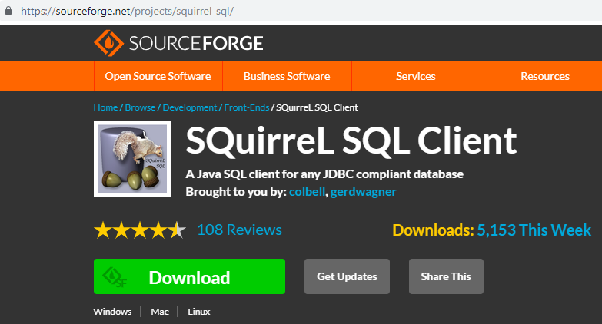
Install Squirrel
Notes:
You can download it from SourceForge here.

Slide 5
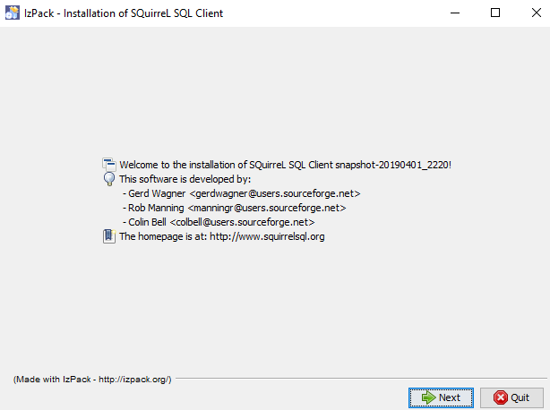
Install Squirrel
Notes:
The download is a jar file. Double-click it to start the installation, and follow the instructions on the installation wizard.

Slide 6
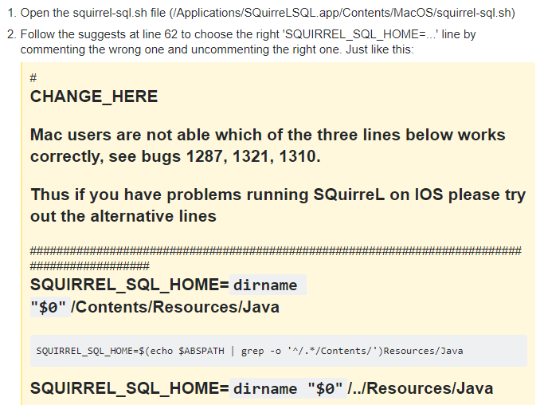
Install Squirrel (Mac)
Notes:
If you are using a Mac, Squirrel may not start. In this case, follow the instructions here and find the configuration option that works on your machine.

Slide 7
Install JDBC Driver
Notes:
Now that Squirrel is installed, let’s install the DSE JDBC driver.

Slide 8
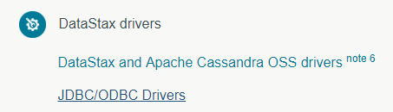
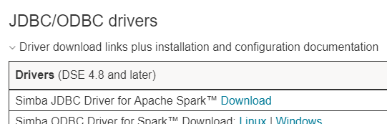
Install JDBC Driver
Notes:
On the DataStax documentation landing page, click the link for JDBC/ODBC Drivers.
<CLICK> This brings up a table of options. Click the Download link for the JDBC driver. The download is a zip file that contains a jar file. Unzip it, and then place the jar file in any convenient location on your machine.

Slide 9
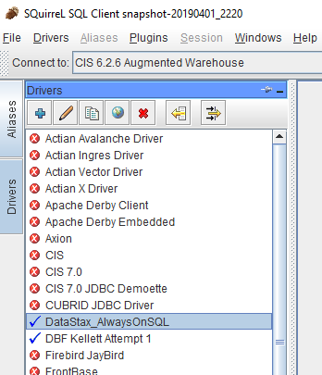
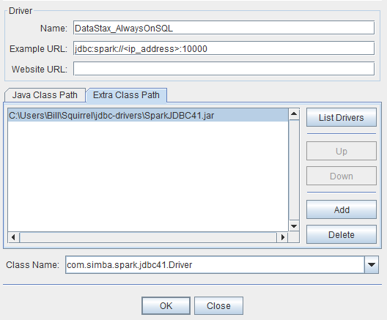
Install JDBC Driver
Notes:
Now open Squirrel…
<CLICK> … and go to the Drivers tab.
<CLICK> Click the plus sign to create a new driver.
<CLICK> On the Driver dialog, fill out the information as shown here.
<CLICK> Give the driver any name you like.
<CLICK> Enter the Example URL pattern: jdbc colon spark colon slash slash, ip underscore address in angle brackets, colon ten thousand. 10,000 is the default port for AlwaysOnSQL.
<CLICK> Click the Extra Class Path tab.
<CLICK> Click Add, and then browse to the directory where you placed the jar file.
<CLICK> The jar path will appear here.
<CLICK> Click List Drivers…
<CLICK> … and the driver’s main class name will appear here.
<CLICK> Click OK, and the driver dialog is complete.

Slide 10
Connect
Notes:
Now we’re ready to make our connection.

Slide 11
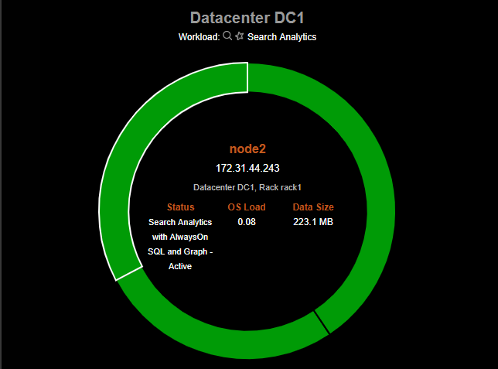
Connect
Notes:
First we need to find a specific IP address for making our connection. Here I’m using OpsCenter.
<CLICK> I see that node 2 is configured for AlwaysOnSQL…
<CLICK> … so I take note of its IP address.

Slide 12
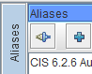
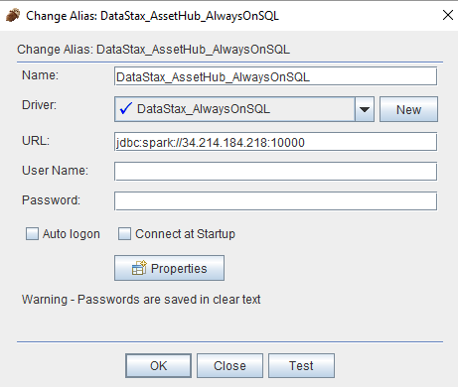
Connect
Notes:
I am now ready to create a specific connection in Squirrel. I go to the Aliases tab and click the plus sign to create a new alias.
<CLICK> Enter information in the Alias creation dialog as shown here.
<CLICK> Give the alias any name you like.
<CLICK> Make sure you are using the Driver definition you created earlier.
<CLICK> Fill out the URL pattern by entering the actual IP address we found earlier. For this workshop cluster, I don’t need a user ID or password.
<CLICK> It’s a good idea to test your connection.
<CLICK> Click OK and the alias is created.

Slide 13
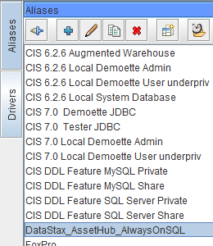
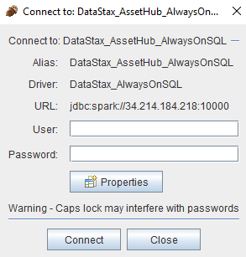
Connect
Notes:
Now I can go to the Aliases tab and double-click my newly-created Alias.
<CLICK> Click Connect.

Slide 14
Query
Notes:
Let’s query the database.

Slide 15
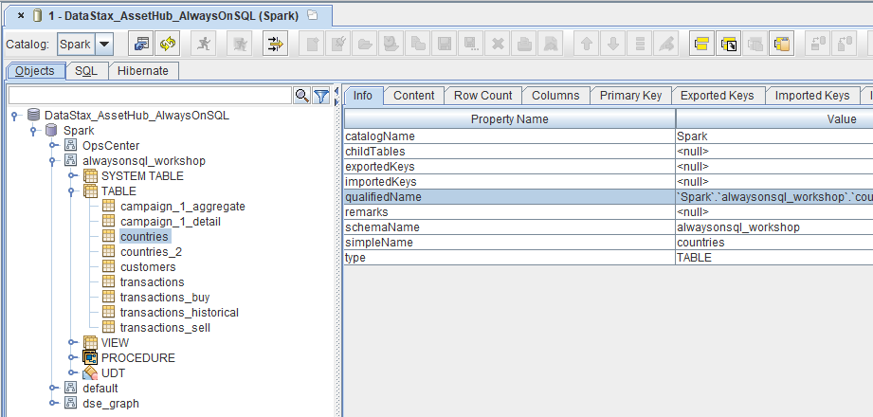
Query
Notes:
Thanks to the JDBC Driver, Squirrel thinks that our DSE cluster is just an ordinary SQL database.
<CLICK> On the Objects tab, we can explore the schemas and tables.

Slide 16
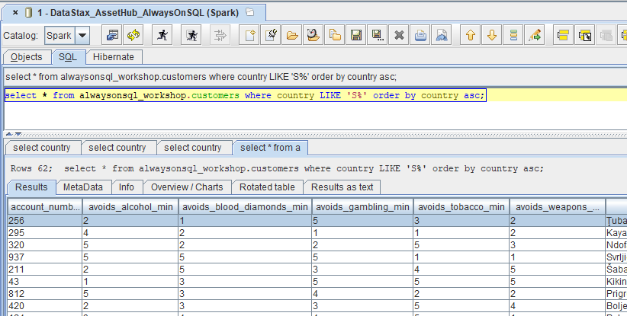
Query
Notes:
On the SQL tab, we can enter queries and view results.
We have used the DSE JDBC driver to enable queries to DSE from third-party SQL-based tools. Our task is complete.

Slide 17









Thank you!
Your Datacenter
Masterless and Active Everywhere Database
Contextual
Always-On
Real-Time
Distributed
Scalable
Notes:
Thank you.

